Slide 1
Chinese Remainder Theorem

Slide 2
Chinese Remainder Theorem (CRT)
The Chinese Remainder Theorem (CRT) is used to solve a set of different congruent equations with one variable but different moduli which are relatively prime as shown below;
X ≡ a₁ (mod m₁)
X ≡ a₂ (mod m₂)
...
X ≡ a_{k} ( mod m_{k})
CRT states that the above equations have a unique solution of the moduli are relatively prime.
Formula for finding X:
X = (a₁M₁M₁⁻¹ + a₂M₂M₂⁻¹ + ... + a_{n}M_{n}M_{n}⁻¹ )mod M

Slide 3
Example - 1
Solve the following equation using CRT.
X ≡ 2 (mod 3)
X ≡ 3 (mod 5)
X ≡ 2 (mod 7)
Solution:
Step 1: Checking Relatively Prime
(3,5) (5,7) and (7,3) -> relatively prime

Slide 4
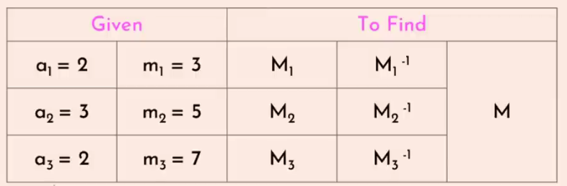
Example - 1 (Contd…..)
X ≡ a₁ (mod m₁)
X ≡ a₂ (mod m₂)
...
X ≡ a_{k} ( mod m_{k})
X ≡ 2 (mod 3)
X ≡ 3 (mod 5)
...
X ≡ 2 ( mod 7)

Slide 5
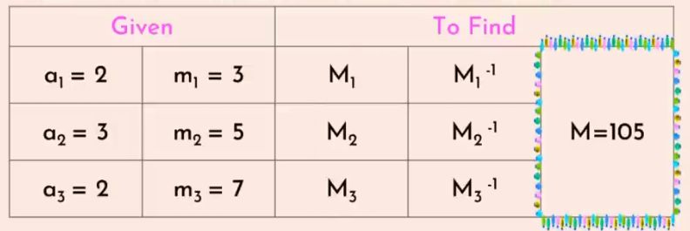
Example - 1 (Contd…..)
Step 2: Compute M
M = m₁ x m₂ x m₃
= 3 x 5 x 7
= 105

Slide 6
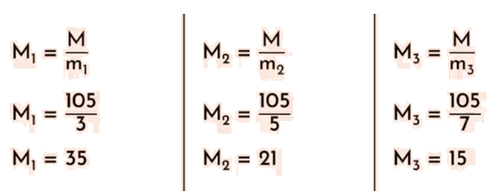
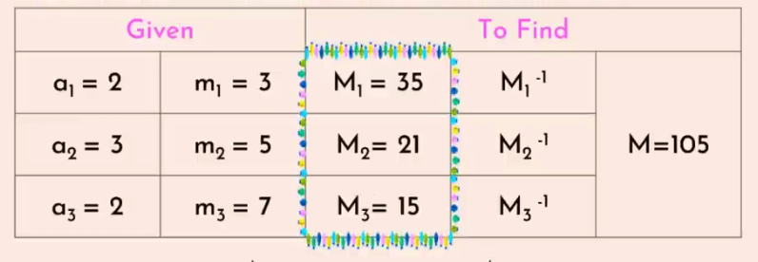
Example - 1 (Contd…..)
Step 3: Compute M1,M2 and M3

Slide 7
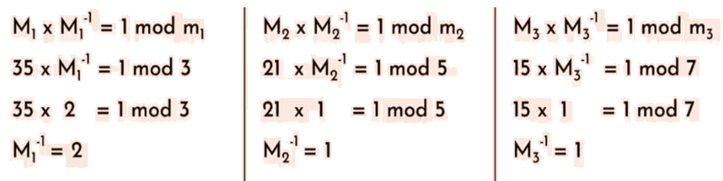
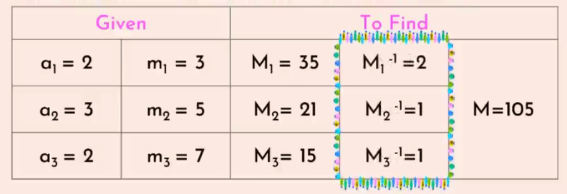
Example - 1 (Contd…..)
Step 4: Compute M⁻¹, M⁻², M⁻³

Slide 8
Example - 1 (Contd…..)
Step 5:
X = (a₁M₁M₁⁻¹ + a₂M₂M₂⁻¹ + a₃M₃M₃⁻¹ )mod M
= (2x35x2 + 3x12x1 + 2x51x1) mod 105
= 233 mod 105
= 23
Note: Finally verify the value of X = 23 in the given equation i.e;
X ≡ 2 (mod 3) → 23 ≡ 2 (mod 3) i.e 23 % 3 = 2
X ≡ 3 (mod 5) → 23 ≡ 3 (mod 5) i.e 23 % 5 = 3
X ≡ 2 (mod 7) → 23 ≡ 2 (mod 7) i.e 23 % 7 = 2

Slide 9
Example - 2
Solve the following equation using CRT.
4X ≡ 5 (mod 9)
2X ≡ 6 (mod 20)
Step 1:
Rewrite the given equations
4X ≡ 5 (mod 9)
Multiply by 4⁻¹ on both sides
4⁻¹ x 4X ≡ 4⁻¹ x 5 (mod 9)
X ≡ 4⁻¹ (mod 9) x 5 (mod 9)
X ≡ 7 x 5 (mod 9) //Since (4 x 7) % 9 = 1
X ≡ 35 (mod 9)
Since 35 % 9 = 8
X ≡ 8 (mod 9)
2X ≡ 6 (mod 20)
2X ≡ 2 x 3 (mod 20)
X ≡ 3 (mod 20)

Slide 10
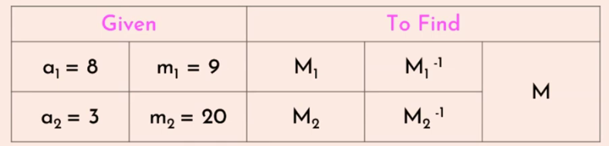
Example – 2 (Contd…..)
Step 2:
X = (a₁M₁M₁⁻¹ + a₂M₂M₂⁻¹ )mod M

Slide 11
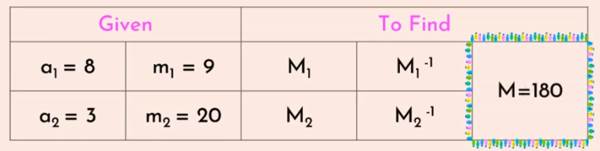
Example – 2 (Contd…..)
Step 3:
M = m₁ x m₂
= 9 x 20 = 180

Slide 12
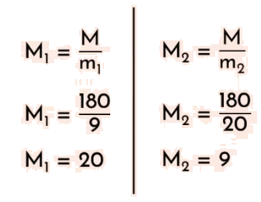
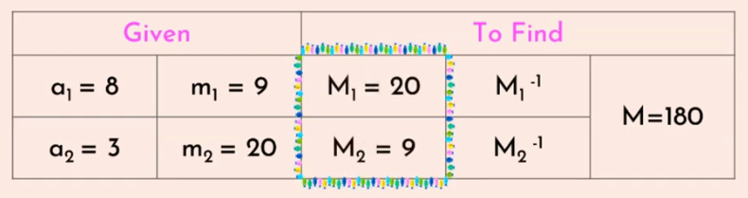
Example – 2 (Contd…..)
Step 3:

Slide 13
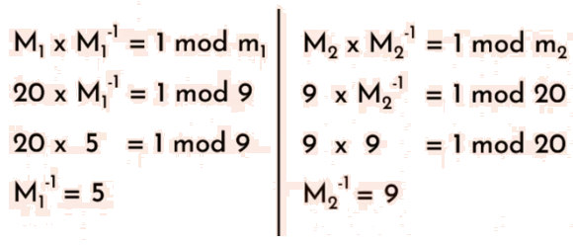
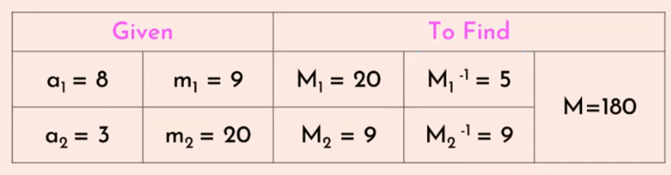
Example – 2 (Contd…..)
Step 4:

Slide 14
Example - 2 (Contd…..)
Step 5:
X = (a₁M₁M₁⁻¹ + a₂M₂M₂⁻¹ )mod M
= (8x20x5 + 3x9x9) mod 180
= (800 + 243) mod 180
= 1043 mod 180 = 143
Note: Finally verify the value of X = 143 in the given equation i.e;
X ≡ 8 (mod 9) → 143 ≡ 8 (mod 9) i.e 143%9 = 8
X ≡ 3 (mod 20) → 143 ≡ 3 (mod 20) i.e 143%20 = 3
Verified

Slide 15
Exercise
1. Find the value of X using CRT.
X ≡ 2 (mod 3)
X ≡ 3 (mod 4)
X ≡ 1 (mod 5)
2. Find the value of X using CRT.
X ≡ 3 (mod 5)
X ≡ 1 (mod 7)
X ≡ 6 (mod 8)
3. Find the value of X using CRT.
X ≡ 5 (mod 3)
X ≡ 2 (mod 5)
X ≡ 1 (mod 11)

